Slide 1

Power BI's Q&A Feature For Natural Language Queries

Slide 2
Q&A (Questions and Answers)
Power BI’s Q&A feature is designed to let users explore data by typing questions in natural language, and it automatically generates visual answers based on available datasets. Power BI’s Q&A feature allows users to interact with data using natural language queries, making it easier to explore data without writing code or complex formulas.

Slide 3
Natural Language Queries (NLQs)
It refers to questions posed in everyday language that a system, like Power BI, can interpret to retrieve specific data insights. In Power BI's Q&A feature, NLQs allow users to interact with datasets by asking questions in a conversational manner, such as "What are last month’s sales by product?" or "Show average profit for each region."

Slide 4
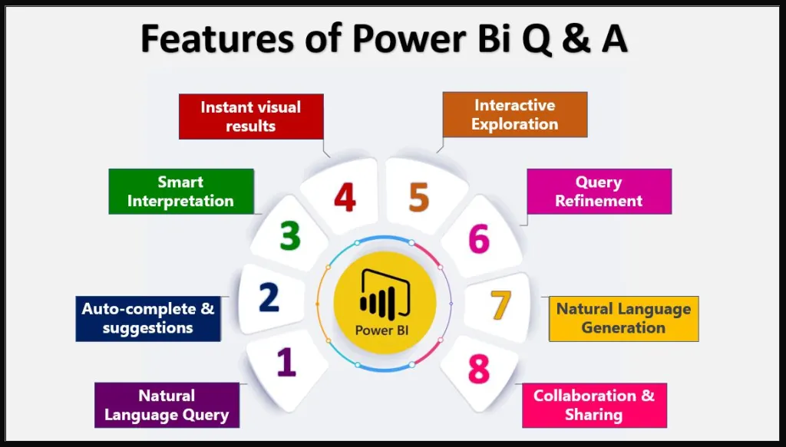
Key Features
Data Sensitivity: Q&A is sensitive to how data is structured. Properly naming columns, tables, and relationships enhances accuracy.
Synonyms: Power BI allows you to add synonyms for fields, making it easier for users to ask questions in various ways
Train Q&A: You can train the Q&A feature by entering sample questions and setting the expected answers, making it better suited to common queries.

Slide 5
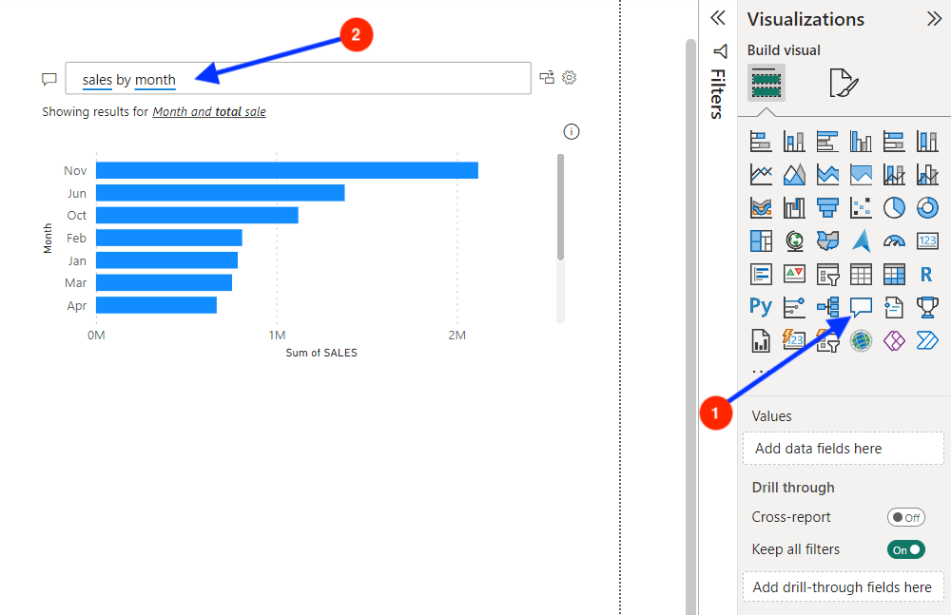
How It Works ??
Natural Language Query: Users can type questions in natural language (like "What was the total sales last month?") in the Q&A box.
Suggestions and Auto-Completion: As you type, Power BI suggests relevant keywords and phrases based on the data available, helping you formulate questions.
Dynamic Visualizations: Based on the question, Power BI generates the most appropriate visualization (e.g., bar chart, pie chart, line chart) and displays it instantly
Rephrasing and Refinement: If the generated visualization isn’t quite right, users can rephrase questions or use the suggested edits Power BI offers to refine the query.

Slide 6

Use Cases
Quick Insights: For business users, it provides a fast way to gather insights without technical knowledge
Exploratory Data Analysis: Data analysts can use Q&A to explore trends, anomalies, and relationships within data interactively.
Dashboards and Reports: Adding a Q&A button to dashboards or reports allows end-users to explore the data further without pre-defined filters or slicers.

Slide 7
Conclusion
Power BI’s Q&A feature brings a new level of accessibility and efficiency to data analysis by allowing users to query data in plain language. This tool empowers users, regardless of their technical background, to gain insights quickly and visually without the need for complex coding or extensive training. By streamlining data exploration through suggestions, automatic visualizations, and customization options, Q&A enhances the interactivity and flexibility of Power BI reports, making it easier for businesses to make data-driven decisions in real-time.

Slide 8


Thank you
ajaycraju98@gmail.Com

